Slide 1
Chapter - 6
Object Lifetime

Slide 2
Topics Covered
Understanding Object Lifetime
The CIL of “new’
The Basics of Garbage Collection
Finalization a Type
The Finalization Process
Building an Ad Hoc Destruction Method
Garbage Collection Optimizations
The System. GC Type.
5-<number>

Slide 3
Introduction to Object Lifetime
What is Object Lifetime?
Every program needs memory.
Stack
Heap
stack keeps track of what’s executing in your code
Heap keeps track of your objects.
5-<number>

Slide 4
Car c = new Car("zen",200,100);
allocate the memory for processing.
Heap keeps track of your objects.
De-allocate an object from memory.
Object lifetime is the time when a block of memory is allocated to this object during some process of execution and that block of memory is released when the process ends.
5-<number>

Slide 5
The CIL of new
C# encounters the new keyword, produce a CIL new object instruction.
CIL to allocate region-of-memory for each created object termed as the 'managed-heap'.
Heap maintains a new-object-pointer to store newly created object.
5-<number>

Slide 6
CLR to perform following sequence of events
calculates total memory required for the new object to be allocated.
  Object contains other internal objects, their memory is also taken into account.
  Memory required for each base class is also taken into account.
2. Examines heap to ensure that there is sufficient memory to store the new object.
  3. CLR advances NOP to point to the next available slot on the heap.
5-<number>

Slide 7
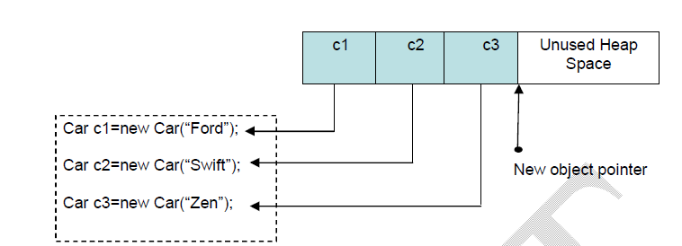
5-<number>

Slide 8
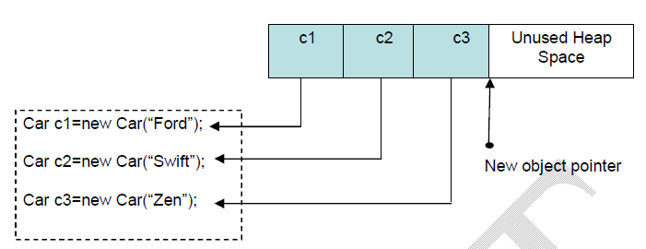
The basics of Garbage collection
After creating so many objects, the managed heap may
become full.
5-<number>

Slide 9
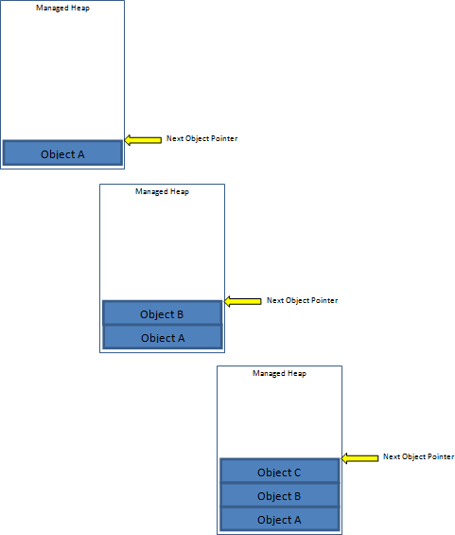
What is Garbage Collection?
5-<number>

Slide 10
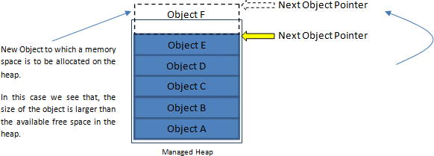
5-<number>

Slide 11
What is Garbage Collection?
A Managed Heap is a pool of memory.
In this, Situation, perform operation called Garbage Collection.
Garbage collection is a process of reclaiming memory occupied by unreachable objects in the application.
5-<number>

Slide 12
How CLR is able to determine an object on the heap that it is no longer needed and destroy it?
Application roots.
A root is a storage location containing a reference to an object on the heap.
Many objects on a heap are linked one to the other forming a chain, depending on which object is referenced by whom. There might be multiple such chains in the heap. The reference to the first object, i.e. the memory location to any such chain is called a Root. Every application has a set of such roots. E.g. the global and static object pointers, any local variable/parameter object pointers and any CPU registers containing pointers to objects.
5-<number>

Slide 13
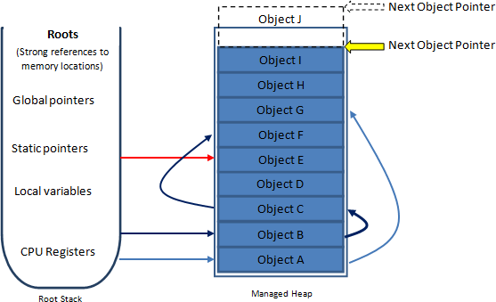
Root can fall into any of the following categories
5-<number>

Slide 14
When a garbage-collection occurs
The CLR will examine all objects on the heap to determine if it is still in use in the application.
Then, the CLR will build an object-graph.
Object-graph represents each object on the heap that is still reachable.
When garbage-collector determines that a given root is no longer used by a given application, the object is marked for termination.
When garbage-collector searches the entire heap for orphaned-root, the underlying memory is reclaimed for each unreachable object.
5-<number>

Slide 15
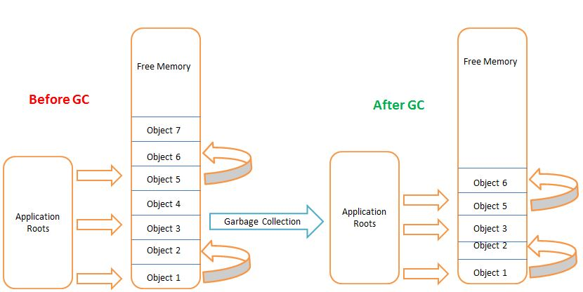
How the Garbage Collector works?
5-<number>

Slide 16
Finalizing a Type
The .NET garbage collection scheme is non-deterministic in nature.
A possibility that the objects are holding unmanaged resources.
Unmanaged resources like network connection, file handle, window handle etc.
Build .NET types that interact with unmanaged resources, we like to ensure that this resource is released in-time rather than waiting for .NET garbage collector.
5-<number>

Slide 17
C# provides an option for overriding the virtual Finalize() method.
Allows an object to try to free resources and perform other cleanup operations before it is reclaimed by garbage collection.
public class Test
{
Protected override void Finalize () // Compile Time error!!!
{
……….
}
}
5-<number>

Slide 18
we need to use a C++ -type destructor syntax:
public class Test
{
~Test()
{
………
}
}
5-<number>

Slide 19
Indirectly Invoking Finalize ()
The .NET runtime will activate garbage collector when it requires more memory that what is available at heap.
Finalization will automatically take place when an application domain or AppDomain is unloaded by CLR.
Once our application is about to shut down, the finalize logic is activated.
5-<number>

Slide 20
using System;
class Test
{
public Test()
{ }
~Test()
{
Console.WriteLine("Finalizing!!!");
}
public static void Main()
{
Console.WriteLine(“Within Main()");
Test t=new Test();
Console.WriteLine(“Exiting Main()");
}
}
5-<number>

Slide 21
The Finalization Process
CLR automatically determines whether this object supports a user-defined Finalize() method.
The object is marked as finalizable and a pointer to this object is stored on an internal queue names as the finalization queue.
The finalization queue is a table maintained by the CLR that points to every object that must be finalized before it is removed from the heap.
it checks every entry on the finalization queue and copies the object from the heap to another CLR-managed structure termed as finalization reachable table (f-reachable).
5-<number>

Slide 22
a separate thread is produced to invoke the Finalize() method for each object on the f-reachable table at the next garbage collection.
when we build a custom-type (user-defined type) that overrides the Finalize() method, the .NET runtime will ensure that this member is called when our object is removed from the managed heap.
But this will consume time and hence affects the performance of our application.
5-<number>

Slide 23
Building an Ad Hoc Destruction Method
objects holding unmanaged resources can be destroyed using Finalize() method.
The process of finalization is time consuming.
write a custom ad hoc method that can be invoked manually before the object goes out of the scope.
Avoid the object being placed at finalization queue and avoid waiting for garbage collector to clean-up.
user-defined method will take care of cleaning up the unmanaged resources.
public class Car {
…………..
public void Kill() { //name of method can be anything
//clean up unmanaged resources
} }
5-<number>

Slide 24
IDisposable Interface
An interface defined in the System namespace.
Defines a single method, named “Dispose”, that is used to perform clean-up activities for an object when it is no longer required.
Method may be called manually, when an object’s work is finished, or automatically during garbage collection.
public interface IDisposable
{
public void Dispose();
}
5-<number>

Slide 25
Our application can implement this interface and define Dispose() method.
Then, this method can be called manually to release unmanaged resources.
Thus, we can avoid the problems with finalization.
5-<number>

Slide 26
using System;
namespace UnmangedMemory {
class DataConnectionManager : Idisposable {
public DataConnectionManager() { }
//Dispose method can be called explicitly or invoked implicitly at the end of a using block
public void Dispose() {
//Clean up unmanaged resources
Console.WriteLine("Here is where you clean up unmanaged resources");
}
}
}
5-<number>

Slide 27
Dispose() method can be called manually before the object goes out of scope.
Method will take care of cleaning up the unmanaged resources.
This method will:
→ Avoid object being placed at finalization-queue.
→ Avoid waiting for garbage collector to clean-up
5-<number>

Slide 28
Using keyword
Another way of cleaning up the unmanaged resources.
public void Test()
{
using(Car c=new Car())
{
//Do something
//Dispose() method is called automatically when this block exits
}
}
5-<number>

Slide 29
Garbage Collection Optimization
Two methodologies for cleaning user-defined types.
When CLR is attempting to locate unreachable objects, it does not literally search through every object placed on the managed heap looking for orphaned roots.
Because, doing so will consume more time for larger applications.
To optimize the collection process, each object on the heap is assigned to a given generation.
5-<number>

Slide 30
The managed heap is organized into three generations so that it can handle short lived and long lived objects efficiently.
Garbage collector first reclaim the short lived objects that occupy a small part of the heap.
idea behind generation:
If an object is on the heap since long time, it means, the object will continue to exist for more time.
Conversely, if an object has been recently placed on the heap, it may be dereferenced by the application quickly.
5-<number>

Slide 31
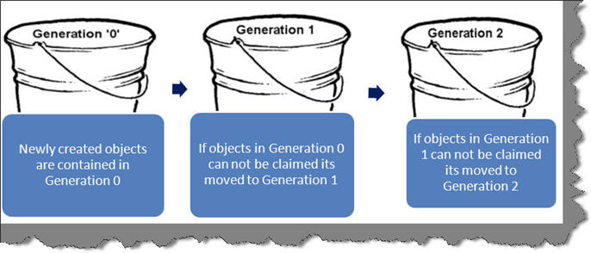

Generation 0 has all the newly created objects. When the application creates objects they first come and fall in the Generation 0 bucket. A time comes when Generation 0 fills up so GC needs to run to free memory resources. So GC starts building the graph and eliminating any objects which are not used in application any more. In case GC is not able to eliminate an object from generation 0 it promotes it to generation 1. If in the coming iterations it’s not able to remove objects from generation 1 it’s promoted to generation 2.
5-<number>

Slide 32
Generation 0:
youngest generation and contains the newly created objects.
Generation 0 has short-lived objects and collected frequently.
The objects that survive the Generation 0 are promoted to Generation 1.
Example: A temporary object.
5-<number>

Slide 33
Generation 1:
This generation contains the longer lived objects that are promoted from generation 0.
The objects that survive the Generation 1 are promoted to Generation 2.
Basically this generation serves as a buffer between short-lived objects and longest-lived objects.
5-<number>

Slide 34
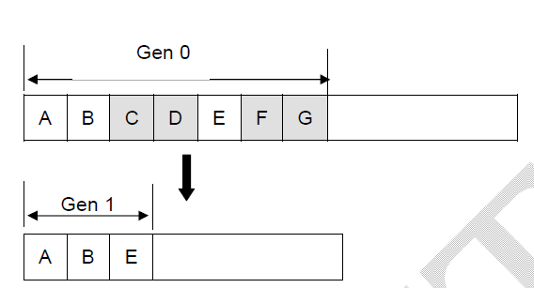
Generation 2
This generation contains the longest lived objects that are promoted from generation 1 and collected infrequently.
5-<number>

Slide 35
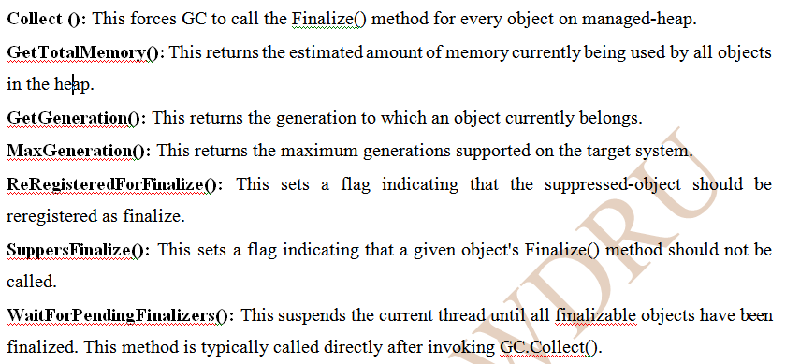
The System.GC Type
interact with the garbage collector using a base class System.GC
System.GC. provides following members:
5-<number>

Slide 36
Building Finalization and Disposable Types
using System;
class Car:IDisposable
{
string name;
public Car(string n)
{
name=n;
}
~Car()
{
Console.WriteLine("Within destructor of {0}", name);
}
5-<number>

Slide 37
public void Dispose() {
Console.WriteLine("Within Dispose() of {0}", name);
GC.SuppressFinalize(this); } }
class Test {
public static void Main() {
Car c1=new Car("One");
Car c2=new Car("Two");
Car c3=new Car("Three");
Car c4=new Car("Four");
c1.Dispose();
c3.Dispose();
} }
5-<number>

Slide 38
Forcing Garbage Collection
CLR will automatically trigger a garbage collection when a managed heap is full.
the programmers, will not be knowing, when this process will happen.
  we can force the garbage collection to occur using the following statements:
  GC.Collect();
  GC.WaitForPendingFinalizers();
  The method WaitForPendingFinalizers() will allow all finalizable objects to perform any necessary cleanup before getting destroyed.
  We can force garbage collection to occur, it is not a good programming practice.
5-<number>

Slide 39
Programmatically Interacting with Generations
The generation of an object currently belongs to using GC.GetGeneration().
  GC.Collect() allows to specify which generation should be checked for valid application roots.
5-<number>

Slide 40
class Car : IDisposable
{
string name;
public Car(string n)
{
name = n;
}
~Car()
{
Console.WriteLine("Within destructor of {0}", name);
}
5-<number>

Slide 41
public void Dispose() {
Console.WriteLine("Within Dispose() of {0}", name);
GC.SuppressFinalize(this); } }
class Test
{
public static void Main()
{
Car c1 = new Car("One");
Car c2 = new Car("Two");
Car c3 = new Car("Three");
Car c4 = new Car("Four");
5-<number>

Slide 42
Console.WriteLine("c1 is Gen {0}", GC.GetGeneration(c1));
Console.WriteLine("c2 is Gen {0}", GC.GetGeneration(c2));
Console.WriteLine("c3 is Gen {0}", GC.GetGeneration(c3));
Console.WriteLine("c4 is Gen {0}", GC.GetGeneration(c4));
c1.Dispose();
c3.Dispose();
GC.Collect(0);
Console.WriteLine("c1 is Gen {0}", GC.GetGeneration(c1));
Console.WriteLine("c2 is Gen {0}", GC.GetGeneration(c2));
Console.WriteLine("c3 is Gen {0}", GC.GetGeneration(c3));
Console.WriteLine("c4 is Gen {0}", GC.GetGeneration(c4));
} }
5-<number>

